Slide 1
Course Outline
I: On Reliability, Error Handling, and Debugging
II: User-Defined Types: classes
III: Memory Model & Basic Resource Management
IV: Object-Oriented Programming
V: Introduction to Templates and STL library
VI: Application Architecture and Using Patterns

Slide 2
Preview
This parts covers:
motivation for C++ templates
using template classes and functions
template parameters
instantiating class/function templates
basic concepts of the C++ standard library
the background and philosophy of STL
iterators, containers, and algorithms

Slide 3
C++ Templates
C++ supports programming using types as parameters (generic programming) through compile-time techniques
template classes and functions can be parameterized by types:
  template <typename T> class Stack; // declarations
  template <typename T> void swap (T&, T&);
a specified template name acts like a new type name within the program
.. Stack <string> .. // a class name
  typedef Stack <string> StringStack; // can rename

Slide 4
C++ Templates (cont.)
a type-parameterized class is not fully defined class but a type generator that can be used to produce new user-defined types
a class template is instantiated to particular class types by providing the missing type parameters:
Stack <int> intStack; // create a stack of integers
Stack <std::string> stringStack; // stack of strings
a template function may also have type parameters that are bound at compile time:
Stack <int> e1, e2; ...
swap (e1, e2); // compiler: swap <int> (e1, e2)

Slide 5
Template Parameters
a class/function templates have three kinds of parameters:
(1) types (built-in or user-defined),
(2) integer constants, and
(3) pointers to objects or functions with external linkage
floating-point numbers, or C-style strings (char *) are not allowed
all template arguments must be compile-time constants

Slide 6
Defining Template Classes
template <typename T, size_t SIZE> // illustrative only
class Stack {
public:
void push (const T& new_item);
T top () const;
void pop ();
bool isEmpty () const;
bool isFull () const;
... // etc. other operations
private:
size_t top_;
T stack_[SIZE];
};

Slide 7
Defining Template Classes (cont.)
template <typename T, size_t SIZE>
Stack <T, SIZE >::Stack () : top_(0) {}
template <typename T, size_t SIZE>
Stack <T, SIZE >::~Stack () {}
template <typename T, size_t SIZE>
void Stack <T, SIZE >::push (const T& new_item) {
PRE_(top_< SIZE,
std::logic_error ("Stack::push() overflow"));
stack_[top_++] = new_item;
}
...

Slide 8
Instantiating Template Classes
the instantiated template names can be used wherever regular class names can:
typedef Stack <double, 50> StackOfDouble;
void foo (const Stack <int, 100>&);
templates are not macros: the instantiated name identifies the same generated class-instance at all places
compiler typically represents the class with some internal name and places its instantiation into some internal repository

Slide 9
Instantiating Template Classes
a class template and its operations are instantiated only when necessary, i.e., when a complete class definition or its particular called operations are required.
e.g., consider creating objects of an instantiated class template:
Stack <int, 100> si; // stack of 100 integers
Stack <double, 50> sd; // stack of 50 doubles
in order to know the actual size of objects, must instantiate the template definition
when pointers or references to a template instance are used, no instantiation is (yet) required

Slide 10
Function Templates
function members of a class template are function templates
can also define stand-alone function templates:
template <typename T>
void swap (T& x, T& y) {
T tmp = x; // use copy constructor
x = y; // use assignment
y = tmp;
}
function templates are (usually) instantiated at compile time by simply calling the function:
int i = 2; int j = 3;
swap (i, j); // void swap <int> (int&, int&)
Integer k (3); Integer m (4);
swap (k, m); // void swap <Integer> (..)

Slide 11
Template Constraints
the operations performed using a template may constrain the parameter types (constraints through use):
template <typename T>
...
... T t1, t2;
... t1 + t2 // some code within a class template..
...
this (implicitly) implies that + should be supported by the type T:
  true for all built-in numerical types
  can be defined for user-defined types (classes)

Slide 12
Template Constraints (cont.)
template parameter dependent code can be checked after the template becomes fully specified at its instantiation
the code may work for some type arguments and fail for some other type arguments
the implicit constraints of a class/function template are required only if the template becomes instantiated (at compile time)
and all templates are instantiated only when really needed (an object is created or an operation is called)

Slide 13
Compilation of Templates
the current way of organizing template code is to avoid separate compilation of declarations and definitions, and instead put all of the template definitions into a header file
the header files are included into each translation unit that instantiates the template
parameterization of types and functions contributes to reusability and adaptability of software components.
the C++ standard library is based on templates and provides examples of their extensive use

Slide 14
STL Background
the Standard Template Library (STL) was developed by Alex Stepanov, originally implemented for Ada
in 1997, STL was accepted by the ANSI/ISO C++ Standards Committee as part of the standard C++ library
adopting STL also affected strongly various language features of C++, especially templates
supports basic data types such as vectors, lists, associative containers (maps, sets), and algorithms such as sorting,
  efficient, and compatible with C/C++ computation model
  non-object-oriented, using templates for reusability

Slide 15
STL Examples
Examples:
std::vector <string> v; // empty vector of strings
... // initialize v
std::vector <string> v1 (v); // copy of v
if (!v.empty ())
std::cout << v.size () << std::endl;
std::list <std::string> s (v.begin (), v.end ());
// list copy of v
std::list <std::string> s1;
... // initialize s1
std::swap (s, s1); // swap two lists

Slide 16
Basic Principles of STL
STL containers available in the STL use type-parameterized templates, rather than classes with inheritance or delegation
there is no common base class for all of the containers
however, containers implement a somewhat standard container interface with similar operations
the standard string was extended to cover STL-like services
STL interfaces do not typically support I/O operations

Slide 17
Introduction to STL
STL (Standard Template Library) provides three generic components:
(1) containers, for holding and owning homogeneous collections of values; a container holds and manages its own memory
(2) iterators are syntactically and semantically similar to C-like pointers; different containers provide different kinds of iterators
(3) algorithms operate on various containers;
algorithms take different kinds of iterators as (generic) parameters;
to execute an algorithm on a container, the algorithm and the container must use compatible iterators
In addition, STL uses:
functors, for using objects as if they were functions (operator ())
various adapters, for adapting a component to provide a different interface

Slide 18
Example of STL (Stroustrup)
#include <vector> // get std::vector
#include <algorithm> // get std::sort and std::reverse
...
int main () {
std::vector <double> v; // buffer for input data
double d;
while (std::cin >> d) // read elements
v.push_back (d);
if (!std::cin.eof ()) { // check if input failed
std::cerr << "format error\n";
return 1; // error return
}
std::cout << "read " << v.size () << " elements\n";
std::reverse (v.begin (), v.end ());
std::cout << "elements in reverse order:\n";
for (int i = 0; i < v.size (); ++i)
std::cout << v [i] << '\n';
}

Slide 19
Basic Concepts
containers are parameterized class templates; they try to make minimal assumptions about the type of elements that they hold (but of course need some operations, e.g., for copying elements
iterators are abstractions, compatible to pointers, that provide access to elements within a particular container; iterators are useful for all kinds of traversals either reading or modifying the elements of the container
algorithms are parameterized function templates; they do not know the actual type of the containers they operate on
algorithms are purposely decoupled from the containers, and they use the iterators to access elements in the container

Slide 20
Basic Concepts (cont.)
STL algorithms have an associated time complexity, implemented with the best efficiency in mind
they are function templates, parameterized by iterators to access the containers they operate on:
vector <int> v;
... // initialize v
sort (v.begin (), v.end ()); // instantiate
deque <double> d;
... // initialize d
sort (d.begin (), d.end ()); // instantiate, again
if a general algorithm, such as sorting, is not available for a specific container, then it is provided as a member operation (e.g., for list)

Slide 21
Introduction to Containers
a container is a class whose objects hold a homogeneous collection of values.
Container <T> c; // initially empty
when you insert an object into a container, you actually insert a copy of this object
c.push_back (value); // grows dynamically
the element type T must support a copy constructor that performs a sufficiently deep copying of object data
heterogeneous collections are represented as containers storing pointers to a base class
cannot use auto_ptr (with the bizarre behavior of its assignment)
smart pointers with reference counting work OK

Slide 22
Intr. to Containers (cont.)
in sequence containers, each element is placed in a certain relative position: as first, second, etc.:
vector <T> vectors, sequences of varying length
deque <T> deques (with operations at either end)
list <T> doubly-linked lists
associative containers, used for representing sorted collections
set <KeyType> sets with unique keys
map <KeyType, ValueType> maps with unique keys
multiset <KeyType> sets with duplicate keys
multimap <KeyType, ValueType> maps with duplicate keys
hash_map <KeyType, ValueType> provided by many lib. impl.
but not (yet) by the standard

Slide 23
Intr. to Containers (cont.)
standard containers are somewhat interchangeable - you can choose the one that is the most efficient for your needs
however, they do provide somewhat different interfaces and services
changing a container may involve changes to the client code
different kinds of algorithms require different kinds of iterators
once you choose a container, you can apply an algorithm that accepts a compatible iterator
container adapters are used to adapt containers for the use of specific interfaces
for example, stacks and queues are adapters of sequences

Slide 24
Vectors
The vector template class represents a resizable (flexible) array
capacity is the maximum number of elements it may get without a reallocation and copying elements
size is the current number of elements actually stored in the vector (always less than or equal to the capacity)
when you insert a new element, and there is no more room, i.e., size already equals capacity, then the vector is reallocated
on reallocation, any iterators or references are invalidated
note that overwriting operations do not reallocate vectors, so the programmer must take care to prevent overflow/memory corruption
size
used part
capacity

Slide 25
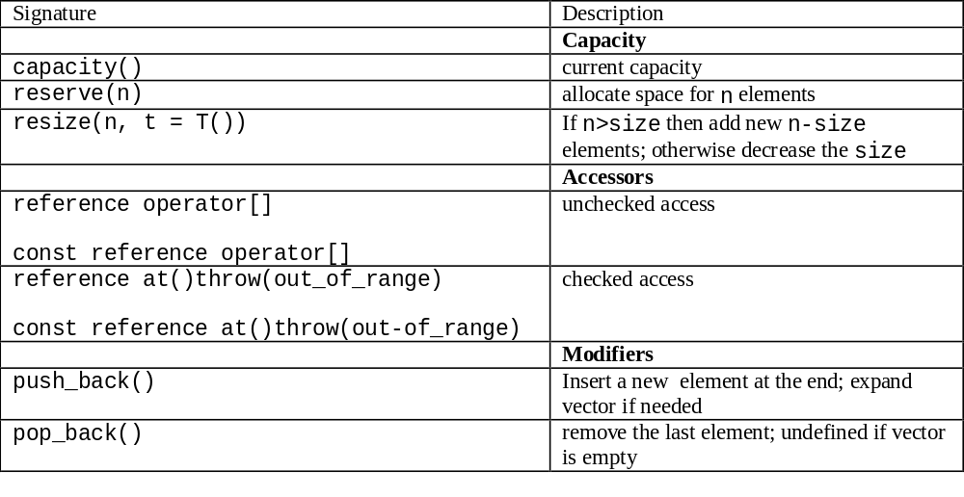
Vectors (cont.)

Slide 26
vector <int> v;
v.reserve (100); // allocate space for 100 integers
// capacity 100, size 0
int i;
while (cin >> i) // read from the standard input
v.push_back (i); // will expand v if needed
for (i = 0; i < v.size (); ++i)
cout << v[i];
try { // use checked access
cout << v.at (100); // may throw
} catch (std::out_of_range&) {
cout << "doesn't have 101 elements" << endl;
}
for (int i = 0; i < v.size () / 2; ++i)
v.pop_back (); // remove second half
vector <int> v1 (v); // copy to v1
v1.insert (v1.begin ()+1, 117); // insert after first

Slide 27
Utilities: pair
a helper class template std::pair, used a lot by the standard library
template <typename T1, typename T2> // simplified
struct pair {
T1 first;
T2 second;
pair () : first (T1()), second (T2()) {} // init
pair (const T1&, const T2&);
... // etc.
};
provides a full range of comparison operations: ==, <, etc.
a related helper function template to make pairs:
std:pair <int, double> w = std::make_pair (1, 1.2);

Slide 28
Associative Containers
STL associative containers:
represent sorted collections
have keys, and are sorted on these keys
A map is a mapping from keys to values:
it stores pairs (key, value)
there may be at most one pair with the same key
e.g.: (123, "Bush") and (124, "Kerry")
A multimap:
may have more than one pair with the same key
e.g., (123, "Bush") and (123, "Kerry")

Slide 29
// map: string to doubles
map <string, double> salaries;
// map: string to doubles sorted by greater <string>
map <string, double, greater <string> > salaries1;
to access an element of a map, you can use an overloaded index operator operator [] (key):
salaries1 ["John"] = 10000;
salaries1 ["Mary"] = 20000;
operator [] can not be used for multimaps; for example
multimap <string, string> mm;
mm ["color"] = "blue"; // compile-time error
instead, you have to use insert ():
mm.insert ("color", "blue");
mm.insert ("color", "green");

Slide 30
when you iterating over maps and multimaps, you actually iterate over pairs of values:
for (salaries1::iterator i = salaries1.begin ();
i != salaries1.end(); ++i)
cout << "name: " << i->first << ' ' <<
<< "salary: " << i->second << endl;
if a key does not yet exist for operator [], then the pair consisting of this key and a default-constructed value, is inserted into the map
typedef map <std::string, size_t> WordCounts; ...
WordCounts count; ...
++count ["word"]; // if absent, insert: ("word", 0)
can use find () to check whether a map already has an entry:
if (count.find ("007") == count.end ()) ...

Slide 31
Associative Containers (cont.)
set is a map for which the key and the value are identical - therefore it stores logically single elements rather than pairs
multisets are sometimes called bags; they are like sets except there may be more than one occurrence of an element with the same key
elements in associative containers are sorted by the value of a key
associative containers use a binary predicate less <Key>, which compares two Key elements, using Key::operator<.
the less predicate also determines the meaning of two keys being equivalent: two keys of an associative container are equivalent if neither is less than the other

Slide 32
Associative Containers (cont.)
In general, a comparison predicate may be provided:
at compile time, as a template parameter (the comparison provided is used for all objects of the template instantiation)
at run-time as a constructor's parameter (you may have different objects that use different comparisons)
Since associative containers are sorted collections:
there are no operations available to modify keys in these collections
you cannot insert at a specific position
set and multiset iterators are constant
map and multimap iterators allow values to be modified (not keys)
you cannot apply algorithms that modify collections to associative containers
iterators are bidirectional, rather than random access

Slide 33
Sequences
There are several kinds of sequences; choose
vectors when
  there are random access operations,
  most insertions and removals are at the end of the container
deques when
  there are frequent insertions and deletions at either end,
  there are random access operations
lists when
  there are frequent insertions and deletions at positions other than at the end
  there are few random access operations
  want to guarantee iterators are valid after modifications

Slide 34
Sequences (cont.)
Examples:
deque <double> d (10, 1.0);
// deque with 10 values (1.0)
vector <Integer> v (10);
// vector with 10 Integers; each with default value
list <Integer> s1; // empty list
// store some elements:
s1.push_front (Integer (6));
s1.insert (s1.end (), Integer (13));
// create list s2 that is a copy of s1
list <Integer> s2 (s1.begin (), s1.end ());
// reinitialize all elements to Integer(2)
s2.assign (s2.size () - 2, Integer(2)); // two fewer

Slide 35
Linked Lists
list <char> s; // empty list
s.insert (s.end (), 'a');
s.insert (s.end (), 'b'); // s has (a, b)
list <char> s1; // empty list
// copy s to s1:
s1.insert (s1.end (), s.begin (), s.end ());
s.clear ();
cout << s1.front ();
s1.erase (s1.begin ()); // remove first element

Slide 36
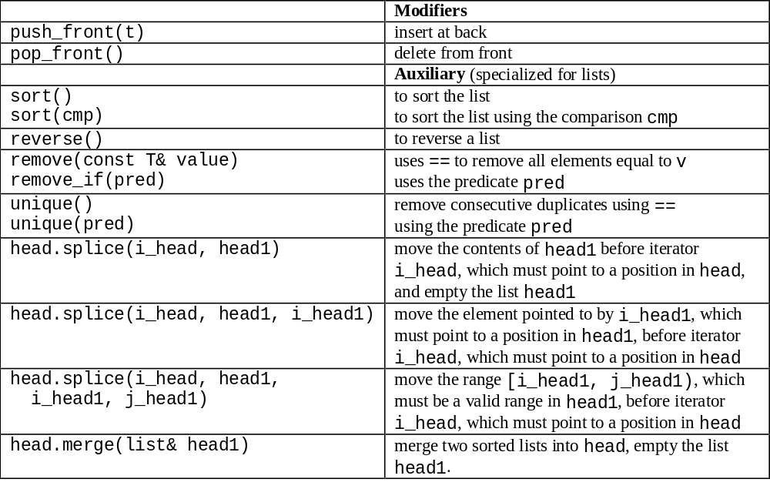
Linked Lists (cont.)

Slide 37
Linked Lists (cont.)
consider a list of Fractions: eliminate duplicates, simplify the fractions, and output the list:
typedef pair <int, int> Fraction;
bool same (const Fraction& one, const Fraction& two) {
return one.first*two.second == one.second*two.first;
}
void simplify (Fraction& p); // assumed implemented
ostream& operator << (ostream& os, const Fraction&);
list <Fraction> h;
h.push_front (make_pair (1,2)); ... // and insert more
h.sort (); h.unique (same); // remove same fractions
for_each (h.begin(), h.end(), simplify); // simplify
ostream_iterator <Fraction> out (cout);
copy (h.begin(), h.end(), out); // output remaining

Slide 38
Deques
deques are similar to vectors
deque iterators are random access
additionally two operations to insert/remove elements in front:
push_front () add new first element
pop_front () remove the first element
deques do not have operations capacity () and reserve ()

Slide 39
Iterators
an iterator provides access to objects stored in a container (points to an element); every iterator it has to support:
*it to access the element currently pointed to by the iterator
++it to move to the next element of the container
it = = it1 to compare two iterators for pointer equality
it ! = it1 to compare two iterators for pointer inequality
every container type provides one or more iterators in a uniform way as standardized type names:
std::vector <string>::iterator
std::vector <string>::const_iterator
begin () returns an iterator pointing to the first element
end () returns an iterator pointing past the end;
serves as a sentinel, i.e., end marker.

Slide 40
Iterators (cont.)
the iterator operations are sufficient for iterating over any Container:
Container c; ...
Container::iterator it;
for (it = c.begin (); it != c.end (); ++it) {
.. *it .. it->op () ..
}
non-const iterators support overwrite semantics
in addition, there are iterator adapters that support insertion semantics
validity of iterators/pointers is not guaranteed (as usual in C/C++)
modifying the organization of a container often invalidates all the iterators and references (this depends on the kind of container and the kind of modification)

Slide 41
Iterators (cont.)
a sequence of consecutive values in the container is determined by an iterator range, defined by two iterators,
[first, last)
last is assumed reachable from first by using the ++ operator, and all iterators, including first but excluding last can be dereferenced
two iterators can be compared for equality and inequality
they are considered equal if they point to the same element of the container (or both just beyond the last value)

Slide 42
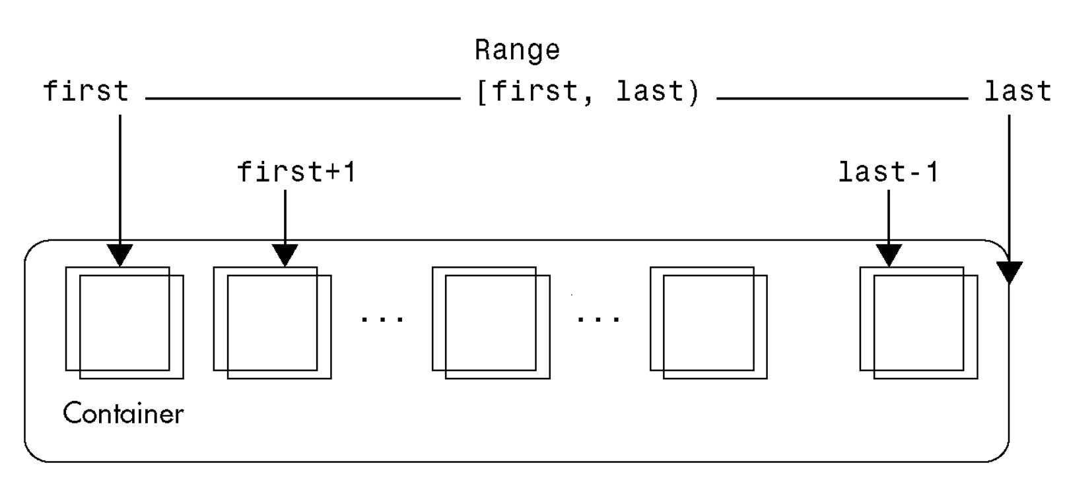
Iterators (cont.)
a container is a discrete set of values, of type value_type
an iterator may either point to an element of this container, or beyond it, using the special past-the-end value
it can be dereferenced by using the operator * (e.g., * it),
and the operator -> (e.g., it->op()).

Slide 43
Iterators (cont.)
to specify the entire primitive array x of size N, use the range
[x, x+N)
to specify a subrange (slice) j .. i -1, 0<= j, j<=i<=N (possibly empty), use the range
[x+j, x+i)
given one iterator it1, and another iterator it2 that was initially equal to it1, and then incremented a number of times, it is often useful to determine the distance between it1 and it2; there is a special type called difference_type
for array-like structures, iterators are (usually) implemented as native (C-style) pointers to elements of the array (e.g., vector)
for other containers (linked lists), iterators are more complicated instances of some class type

Slide 44
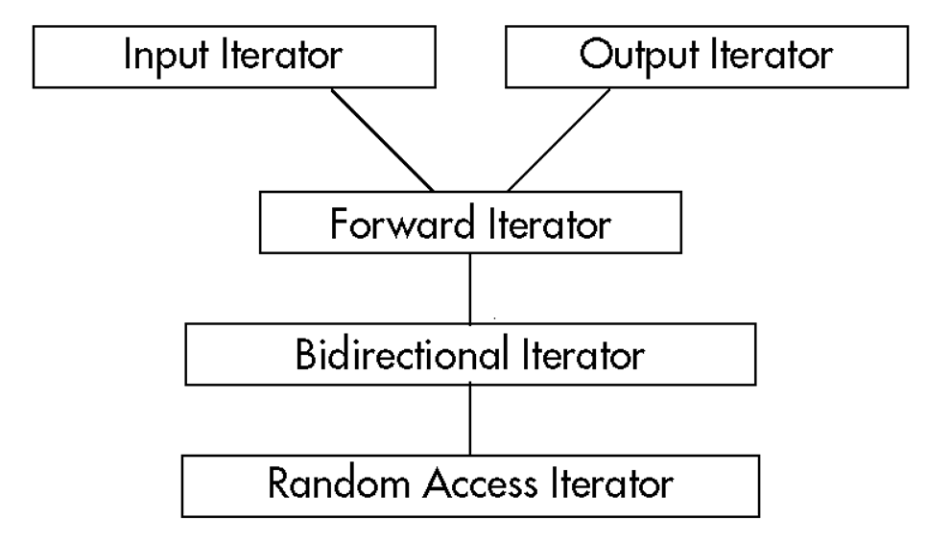
Iterators (cont.)
Input Iterator: ..=*it ++
Output Iterator: *it=.. ++
Forward Iterator: multipass
Bidirectional Iterator: --
Random Access
Iterator: [] it+i it-i

Slide 45
Iterators (cont.)
random iterators can be subtracted, so last-first is the distance between these two iterators, equal to the number of elements in this range
you may add and subtract integers from random iterators
sometimes, you need the empty range, which for example can be specified as [first, first)

Slide 46
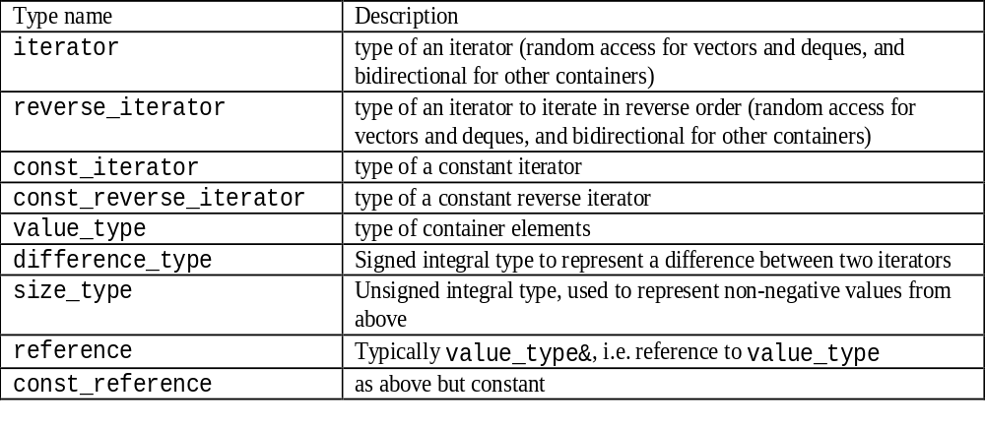
Container Traits

Slide 47
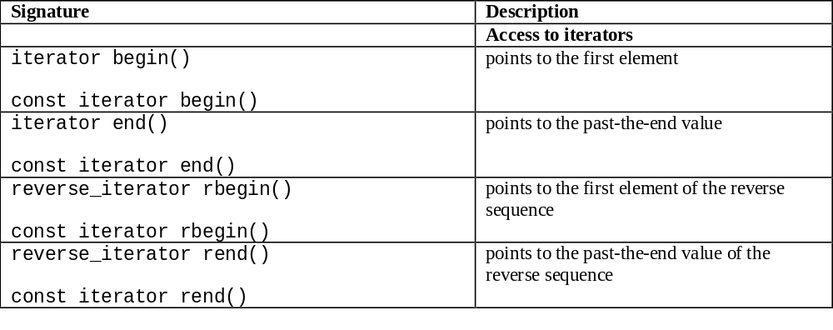
Container Operations

Slide 48
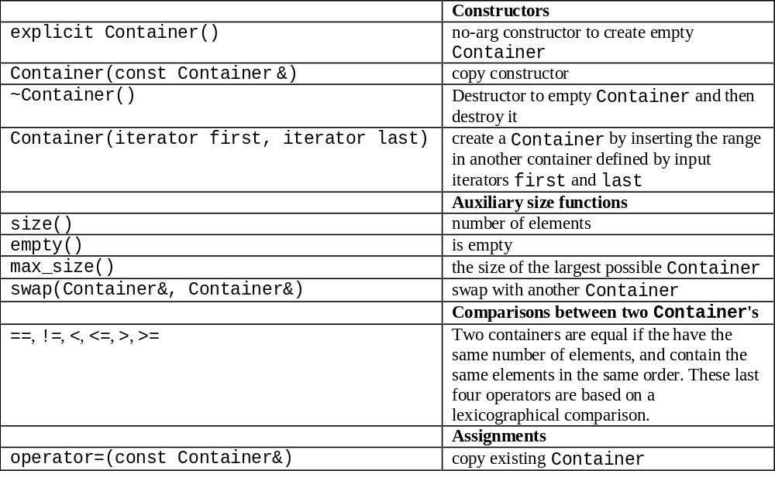

Slide 49
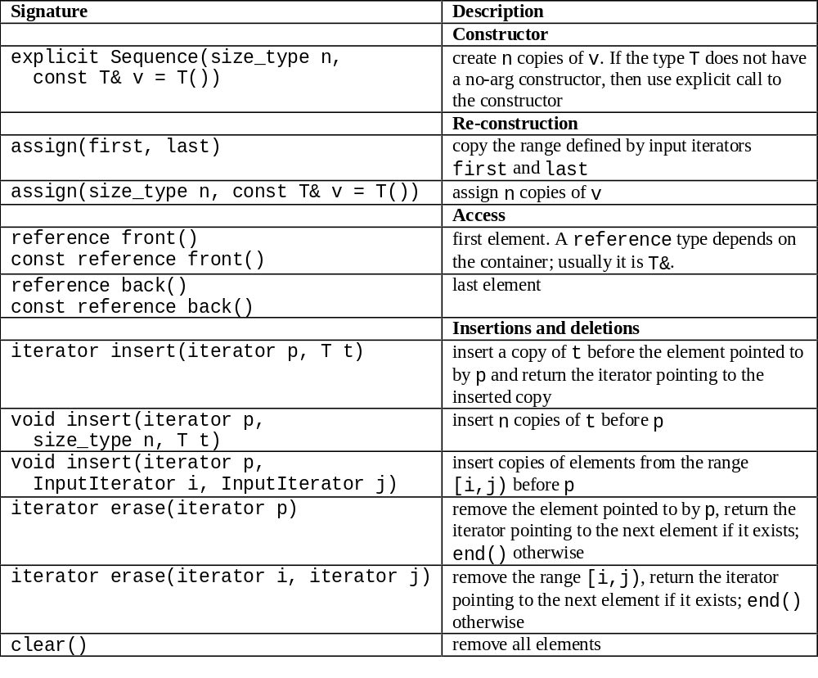

Slide 50
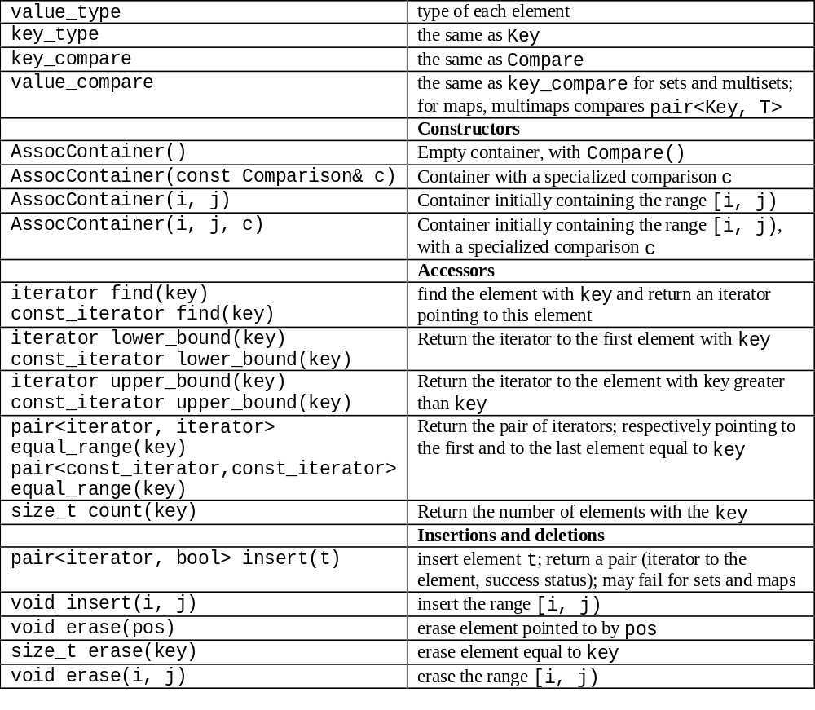

Slide 51
An Example
assume that you have a file "b.dat" containing some names and salaries
there may be duplicate names
you want to read this file
output the salaries of people recorded in the file

Slide 52
An Example (cont.)
typedef pair <string, double> STR_D;
typedef istream_iterator <STR_D> Input;
typedef multimap <string, double>::const_iterator MI;
istream& operator >> (istream& os, STR_D& ip);
multimap <string, double> store;
ifstream ifs ("b.dat");
Input eof;
for (Input i (ifs); i != eof; ++i) // store file
store.insert (*i);

Slide 53
An Example (cont.)
while (1) {
cout << "enter name "; string name;
if (!(cin >> name))
break;
pair <MI, MI> found;
found = store.equal_range (name);
if (found.first == found.second)
cout << "No " << name
<< " found" << endl;
else {
cout << "Name: " << name << endl;
for (MI p = found.first; p != found.second; ++p)
cout << p->second << endl;
}
}

Slide 54
More examples
set <double> sd; // sorted by less <double>
typedef set <double, greater <double> > Dset;
// sorted by greater<double>
set <double, greater <double> > s;
fill (s.begin (), s.end (), 0); // can't use mutating
s.insert (0); // insert 0 to s
s.insert (0); // correct, but does nothing
vector <int> v;
generate_n (back_inserter (v), 10, rand); // store ten
s.insert (v.begin(), v.end ()); // copy to the set

Slide 55
More examples (cont.)
multiset <double> ms (v.begin (), v.end ());
if (s.find (5) != s.end )) // if 5 is in a set, erase
s.erase (5);
int i = ms.count (5); // find how many times 5
cout << "5 found" << i << " times" << endl;
typedef multiset<double>::iterator MI;
pair <MI, MI> res = ms.equal_range (5);
ms.erase (res.first, res.second); // erase all 5 values

